Slide 1

Health & Life Stroke Prediction
By Deshan Pillay

Slide 2



Agenda
Stakeholder introduction & problem
Brief introduction to the data provided.
Visualizations and summary of key findings.
Brief description of the strengths and limitations for the model.
Impact of false positive and false negative.
Recommendations

Slide 3




Stakeholder Introduction: Business Problem:
This report was prepared for the Health (Medical Aid) and Life insurance sector of the business.
The World Health Organization (WHO) have identified that ‘strokes' are the 2nd leading cause of death globally and responsible for 11% of total deaths.
The business does not currently have a model to predict the possibility of a client having a stroke and therefore unable to make an informed decision regarding the premiums offered when onboarding new clients.
The business would also like add these predictions in their existing client's health care assessment and to assist the client in living a healthier life.

Slide 4

The Data - Brief Introduction
The stakeholders have provided a dataset of client's information
The dataset contains 11 columns, namely:
Gender
Age
Hypertension
Heart disease
Ever married
Work type
Residence type
Avg glucose levels
BMI
Smoking Status
Stroke ( This is our Target value)
The dataset contains 5110 rows ( prior to cleaning)
The problem which needs to be solved is a Classification problem.
The target column is ‘Stroke’ and this is classified as either 0 (no stroke) or 1 (stroke)
The data will be inspected, cleaned , visualized and modeled to determine any trends and predictions.

Slide 5
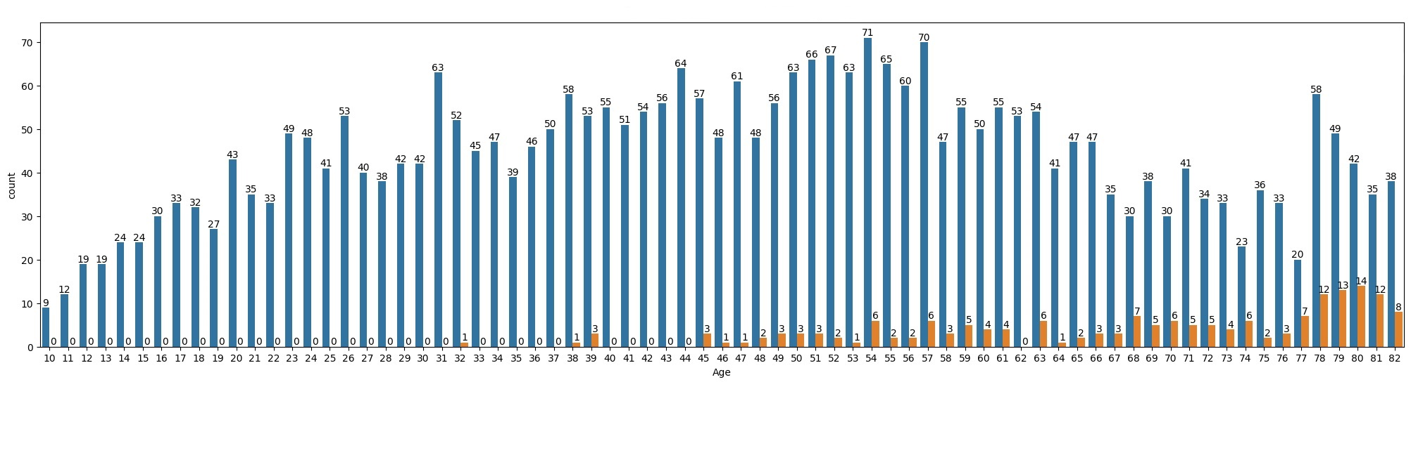
Stroke/Non-Stroke Clients Vs Client Age
Stroke
no
yes
Analysis:
The graph illustrates a comparison between a person's age and whether they have previously had a stroke.
The cleaned data produced 4908 rows of data of which 209 rows indicated that the client previously had a stroke (4.25%). 95.75% of clients did not have a stroke.
From the 4.25% of stroke clients, majority of clients who had a stroke are 45 years and older of age (97.6%), we can therefore assume that as you age the probability of having a stroke increases.
The graph also indicates that from the 4.25%, clients aged 76 years and older are at high-risk for having a stroke.

Slide 6
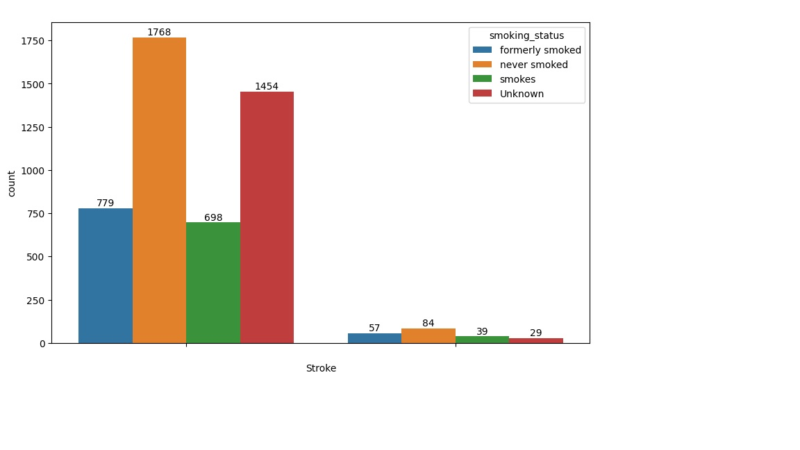
Stroke/Non-Stroke Clients Vs Client Smoking Status
Non-Stroke | % | Stroke | %
Non-smoker | 38 | Non-smoker | 40
Unknown | 30 | Unknown | 14
Formerly-smoked | 17 | Formerly-smoked | 27
Smoker | 15 | Smoker | 19
no
yes
Analysis:
The graph illustrates the smoking status for each client and split according to their stroke status.
38% of non-stroke clients are non-smokers while 15% are smokers.
40% of stroke clients are non-smokers, 27% formerly smoked, 19% smokes and 14% of clients have an unknown status.
The data indicates that smoking is not a high factor for having a stroke.
We have a total of 737 clients who are smokers of which 39 of those clients had a stroke.
What is unusual is that 40% of clients which had a stroke are non-smokers followed by clients who formerly smoked (27%) therefore further proving that smoking is not a high factor for having a stroke however the high percentage for non-smokers and former smokers could be a result of secondhand smoking which will need to be investigated.
The unknow status of 14% were kept in the data as this could change the dynamics of the results. The data’s accuracy will change once we obtain a smoking status for those clients.

Slide 7
Strengths and Limitations of Model
Multiple models were applied and 95% of the models produced a similar result. The model which I applied is the Bagging's Classifier Model with applying PCA.
The model predicted a 96% accuracy within the fastest time frame for the test data.
PCA Strengths | PCA Limitations
Removes Correlated Features | Independent variables become less interpretable
Improves Algorithm Performance | Data must be standardized before applying PCA
Reduces Overfitting | Information loss
Improves Visualization

Slide 8
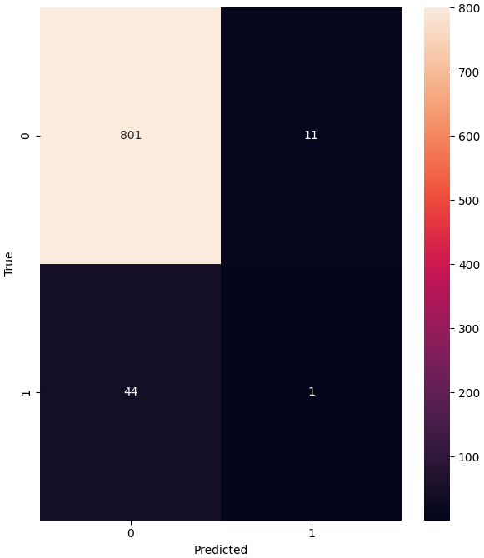
Strengths and Limitations of Model
Impact of False Positives and False Negatives
False Positives (11):
The impact here would mean that we predicted the client had a stroke but in did not.
The clients' premiums would have been higher
False Negative (44):
We predicted that the client did not have a stroke, however the client did have a stroke.
This could be a fatal incorrect prediction.
The stroke could have been avoided if the prediction was correct and the correct advice and care could have been provided.

Slide 9

Recommendation
The model cannot be used, the model needs to be 100% accurate as we are predicting a disease which involves a client's life.
Additional client information is required such as their lifestyle, exposure to secondhand smoke, family history, dietary etc.
The dataset needs to be larger as we were unable to find any correlations in the current dataset.

Slide 10


Thank You

